Slide 1


Slide 2
As an app developer I want to instantly update my app in CF
Xiwen Cheng, Tech Lead Cloud, Mendix

Slide 3
“As a developer, you’re being asked to innovate quicker, respond to customers & fail faster”
– Abby Kearns
(CF Summit, June 2017)
https://twitter.com/cloudfoundry/status/874760794814205952
Notes:
Earlier this year Abby Kearns kicked off Cfsummit Silicon Valley stating “As a developer, you’re being asked to innovate quicker, respond to customers and fail faster”. Cloud Foundry does a great job fulfilling this mission. This is certainly true for testing, acceptance, staging all the way to production environments. However not so great for development, unless you use `cf fast-push`.

Slide 4
Use Cloud Foundry as app development environment
Notes:
So why would you ever want to use CF as your development environment?

Slide 5
Services Marketplace
cf create-service
cf bind-service
Notes:
First off the services marketplace is amazing. Consuming a service is just 2 commands away: cf create-service to create for a postgresql database and cf bind-service to expose this database to your app. Now you can focus on your main job: write code that matters. No need to spend days setting up your development environment anymore.

Slide 6
Integrations
Notes:
Secondly two-way integrations is now possible. Imagine your app calls some external REST API. This API has a callback to your app. This would not work if your app was running locally. Or your stakeholder can simply refresh the app from the other side of the world after you made the change.

Slide 7
Identical environments
Notes:
Finally there will be no more surprises moving your app from development phase to staging or production because the environments are all identical.

Slide 8
Develop a PHP web app
Notes:
So there are enough reasons to use CF as an app development environment. Let’s do an experiment: develop a PHP web app in CF.
Please raise your hand if you use PHP or have used it in the past?
Also if you know someone that uses PHP?
So PHP is a very popular language. One of the reasons is its simplicity.
The source file is edited
Saved to disk
Refresh the browser
Confirm your creation and repeat the cycle
It’s fantastic how easy and fast you can iterate with PHP.
Source: http://www.mobiloitte.com/blog/php-popular

Slide 9
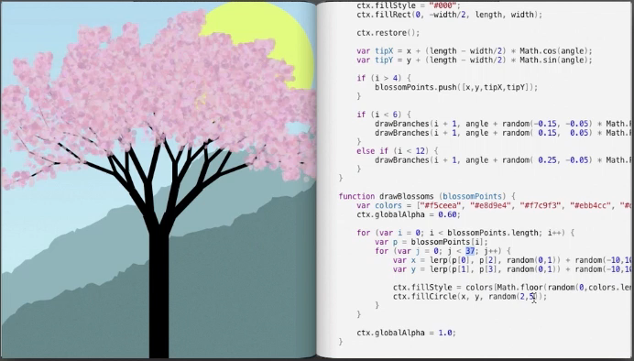
Live Programming
Bret Victor – Inventing on Principle
vimeo.com/36579366
Notes:
Iterations with PHP are often a matter of seconds. If we lower the delay to zero we end up with Live Programming. This short video shows how you can play around with code and the canvas on the left is updated live. This change of mindset enables us to experiment more freely and creatively. You should take a look at Bret Victor’s presentation “Inventing on Principle”.

Slide 10
cf push phpapp
50s
Notes:
Let’s get back to our PHP experiment. Once you’ve written your script it needs to up deployed. This is done using cf push. cf push takes 50s to deploy a simple php app.

Slide 11
Speed comparison
Notes:
CF is 50 times slower than uploading a single file to a remote server with direct filesystem access. And just 50 thousand times slower than local development.

Slide 12
cf logs --recent
Notes:
Why does it take 50 seconds to deploy? The cf cli has this amazing command cf logs –recent. Using this command we can investigate how the time is spent during a cf push.

Slide 13
cf push: 50 seconds
Notes:
Instead of looking at white text on black screen I’ve summarized the timings in this diagram grouped by phases. First your app sources are uploaded to CF. Then the buildpack kicks in to do the necessary preparations to run the app. Next a droplet is created and uploaded to the blobstore. And finally a container is started with your droplet. API call overhead and other initialization are classified as “Other”.

Slide 14
Notes:
While you are waiting for `cf push` you might think I could use the #1 programmer excuse to slack off.

Slide 15
Notes:
However 50 seconds isn’t enough for a ping pong game

Slide 16
Notes:
So you get a cup of coffee instead

Slide 17
Notes:
A second one while you wait again because you love committing frequently and show how hard you work.

Slide 18
Notes:
At the end of the day you’ve had quite some coffee

Slide 19
Notes:
And wonder if you had too much coffee or having another panic attack

Slide 20
Notes:
This doesn’t have to be true

Slide 21
cf fast-push: 5 seconds
10x faster!
Notes:
Because with cf fast-push the job finishes in 5 seconds. It’s so fast you don’t have time to slack off or get coffee. I’m really sorry, but you have to find another excuse.
Currently it is 10 times faster than traditional cf push. And there is still plenty of room for improvements.

Slide 22
How does it work?
CF CLI
POST /_fastpush
App Container
Controller
APP
Update Files
Views app
Notes:
cf fast-push is a cf cli plugin. When invoked it synchronizes your local app source with files in the container instance running in CF. This is possible thanks to the controller living next to your app in the same container. This container does live modifications to the container and restarts the app process if needed. Because of this direct access in the container we skip most of the time consuming tasks in a regular cf push like compiling, droplet built and needless restarts.

Slide 23
Live Demo
Notes:
Here we have a very simple php app with a single index.php file. `find .` This app is running in PWS. `shows the app in the browser`. Let’s change our file. `vim htdocs/index.php`. And update it using fast-push. Here we see it took a few seconds to complete and only the index.php file has been synchronized. `shows browser again`.

Slide 24
Alternatives
Cloudrocker: https://github.com/CloudCredo/cloudrocker
Bluemix Live Sync: https://console.bluemix.net/docs/develop/bluemixlive.html
cf ssh ☺
Notes:
Fast-push is certainly not the first that helps developers deliver faster. There are other alternatives like cloudrocker and bluemix live sync. Each one of them has their own drawbacks. Or you can simply use `cf ssh` to edit files in place which works out of the box for some use cases

Slide 25
Thanks!
Github: github.com/xiwenc/fastpush
Twitter: @xiwenc
We are hiring: mendix.com/careers/
Notes:
Thank you for your attention! Fast push is opensource and hosted on github.

